Slide 1
August Goers
Connecting Business Strategy to NABCEP Key Job Tasks

Slide 2
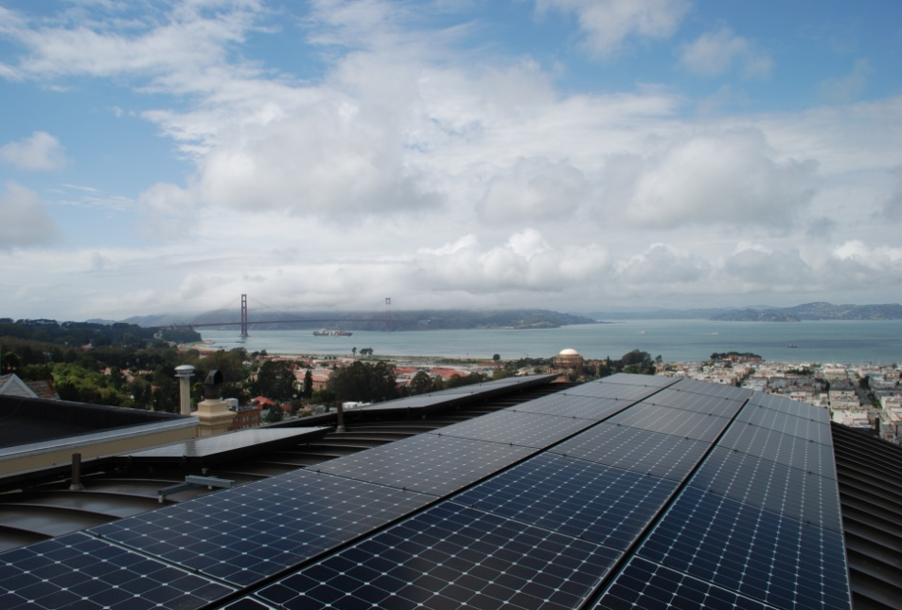
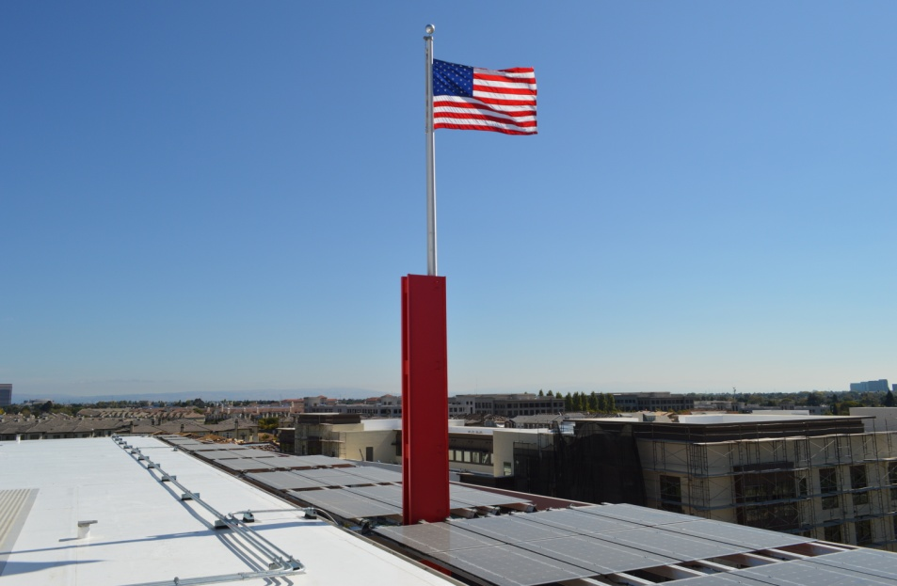
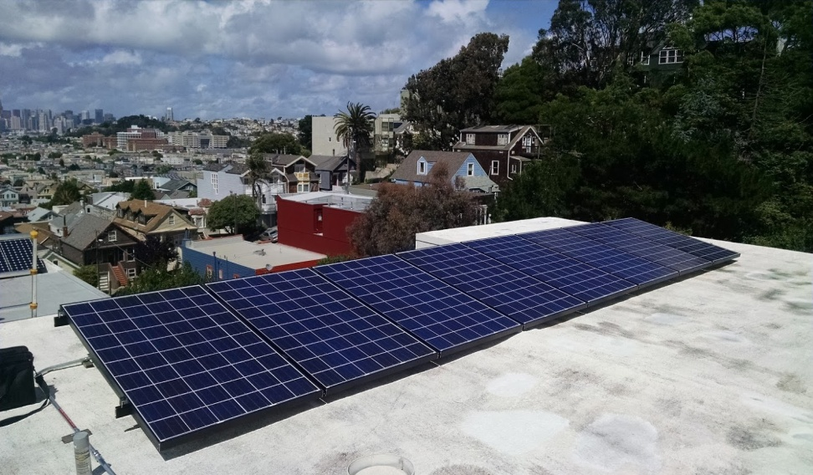
San Francisco Solar

Slide 3
Luminalt
Founded in 2004
San Francisco’s market leader
33 employees, $7M revenue
Multiple time SunPower Outstanding Customer Service Excellence Award Winner
All stages of project performed in-house
Focused and sustained commitment to the highest standards of quality and customer satisfaction

Slide 4
Consistent Focus
Absolute customer satisfaction – 75% of business comes from referrals
Technical excellence – sales through post-install
Continually develop and improve processes

Slide 5
5 Star Reviews

Slide 6
How Do We Maintain Excellence?

Slide 7
Solar is Easy! (Not)

Slide 9
Foundation of Quality
10 year warranty – long term commitment
Superior
Up front expectations / contracts
Materials & equipment
Designs
Tools – software and hardware
Feedback loops
Track cases
93% of our cases are due to equipment issues
7% arise from installation, process, or communication issues

Slide 10
Management Structure
Owners can’t do everything
Transition from do it yourself attitude to delegation and departments
Managers bring new skills to the table
Empathy with their team members
Unbiased decision making and spending ability
Departmental-specific skills such as engineering, accounting, marketing, project management, etc
Lessons learned from setting up management structure

Slide 11
Don’t Join Race to the Bottom
Competitors come and go
Focus on value rather than low cost
Don’t over promise and under deliver
Underperforming systems
Commissioning incomplete
Lack of customer service responsiveness
Shortcuts lead to failures
Roof leaks or other major system failures
Slow and steady wins the race

Slide 12
TYING IT TOGETHER – NABCEP JOB TASK ANALYSIS
“The purpose of this Job Task Analysis is to define a general set of knowledge, skills, and abilities typically required of Solar PV installers who are responsible for the specification, installation, and maintenance of PV systems.”
“Designing Systems (30%) • Managing the Project (17%) • Installing Electrical Components (22%) • Installing Mechanical Components (8%) • Completing System Installation (12%) • Conducting Maintenance and Troubleshooting Activities (11%)”

Slide 13
THANKS!
August Goers
Chief Operating Officer
Luminalt
415.641.4000
august@luminalt.com

