Slide 1
Connecting Business Strategy to NABCEP Key Job Tasks

Slide 2
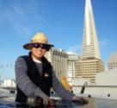
Sun Light & Power – Experience & Capabilities
Solar Design/Build Company Since 1976
65% small commercial/ multi-family PV
30% small commercial/ multi-family ST
5% residential PV
Experienced Engineering Team
10 engineers on staff
5 LEED AP’s
8 NABCEP Certified installers
In-house Installation Capability
9 active crews – minimal subcontracting
4 Superintendents

Slide 3
Sun Light & Power – Values and Commitment
Committed To Corporate Responsibility
Certified CA Benefit Corporation
100% Biodiesel fleet, plus 4 electric vehicles
Core Values: Integrity, Quality, Sustainability, Teamwork, Diversity
Committed to Community
Community outreach and involvement – specialize in Affordable Housing
Hire and train graduates of community education programs (9 on staff)
Provide formerly at-risk people real opportunities to improve their lives
Strongly encourage biking to work to promote a healthy lifestyle and neighborhood connection and pride

Slide 4
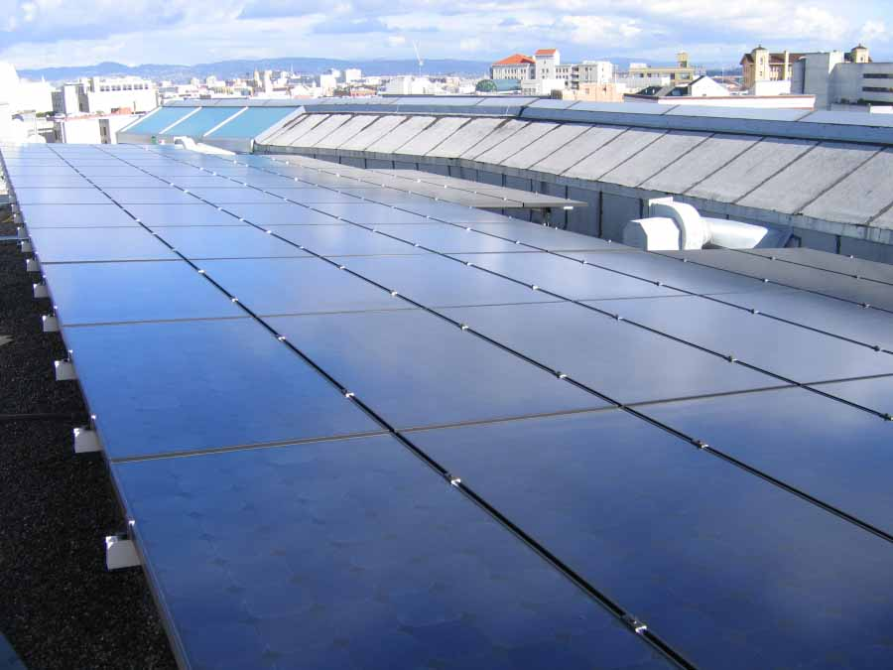
Aligning around Quality/NABCEP
NABCEP = QUALITY
“Never Compromise on Quality” is a SLP core value
Slow and accurate beats fast and sloppy in the long run
Create accountability around quality results
Engineering department always reviews project closeouts
Notes:
Some call it the three E’s -- equity, the environment, and the economy. Others label it the three P’s -- people, the planet, and profits. Whichever letter in the alphabet they use, companies of all sizes and shapes around the world are seriously embracing sustainability practices and processes in their core business functions.
Regardless of the descriptive language, companies know that their top and bottom lines will increasingly depend on how deeply they commit to sustainability and how accurately they track, measure, and report their progress in this area. In view of this looming financial imperative, many large global enterprises, including Walmart, have already plowed significant time, energy, and resources into sustainability efforts. But so have small- and medium-size firms on Main Street. A recent study of 20,000 of these companies in Ohio, Pennsylvania, and North Carolina, for instance, found that 70 percent are adopting sustainable business practices because they increase success. Bob Bunting: October 4, 2010
A New Wave of Measurement and Reporting Is on the Way http://www.greentechmedia.com/articles/read/a-new-wave-of-measurement-and-reporting-is-on-the-way/
There are five main reasons companies are interested in conducting business in a sustainable manner:
Supplier networks demand it. Companies such as Walmart, which has more than 100,000 suppliers, are now requiring that vendors collaborate on sustainability initiatives. If a business wants to continue receiving orders from big customers like this, it will follow suit on sustainability.
Government contracts necessitate it. City, state, and federal purchasing agents are, in more and more cases, not permitted to do business with vendors who have a poor or nonexistent track record when it comes to sustainability. Over time, sustainability, diversity, and price may become the three most important variables for winning public-sector contracts.
Customers require it. More than 80 percent of all consumers surveyed in a 2009 national poll indicated that it’s somewhat or very important that the companies they purchase from practice sustainable business.
Potential employees insist on it. A recent study of employees between the ages of 18 and 35 in the United States, the European Union, India, and China found that 96 percent of them want to work for a company that’s committed to sustainability.
Public policy encourages it. President Obama has said that he wants 25 percent of our nation’s energy to be renewable by 2025. And the states have been busy shaping energy policy, too. Right now, 46 states are using tax incentives to help boost renewable energy companies, 32 states offer financing or loans for companies seeking to expand their renewable energy presence, 22 states provide rebates for renewable energy activities, 29 states and the District of Columbia have established renewable portfolio standards, and 19 states have embraced energy efficiency standards.

Slide 5
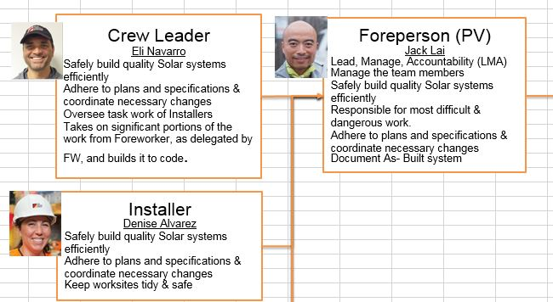
The people are the company
Attitude trumps aptitude
Hire based on the right personality for the job (Predictive Index)
Promote based on performance and safety – clearly defined skills must be achieved
Create and maintain accountability – Accountability Chart rather than Org Chart
Notes:
Some call it the three E’s -- equity, the environment, and the economy. Others label it the three P’s -- people, the planet, and profits. Whichever letter in the alphabet they use, companies of all sizes and shapes around the world are seriously embracing sustainability practices and processes in their core business functions.
Regardless of the descriptive language, companies know that their top and bottom lines will increasingly depend on how deeply they commit to sustainability and how accurately they track, measure, and report their progress in this area. In view of this looming financial imperative, many large global enterprises, including Walmart, have already plowed significant time, energy, and resources into sustainability efforts. But so have small- and medium-size firms on Main Street. A recent study of 20,000 of these companies in Ohio, Pennsylvania, and North Carolina, for instance, found that 70 percent are adopting sustainable business practices because they increase success. Bob Bunting: October 4, 2010
A New Wave of Measurement and Reporting Is on the Way http://www.greentechmedia.com/articles/read/a-new-wave-of-measurement-and-reporting-is-on-the-way/
There are five main reasons companies are interested in conducting business in a sustainable manner:
Supplier networks demand it. Companies such as Walmart, which has more than 100,000 suppliers, are now requiring that vendors collaborate on sustainability initiatives. If a business wants to continue receiving orders from big customers like this, it will follow suit on sustainability.
Government contracts necessitate it. City, state, and federal purchasing agents are, in more and more cases, not permitted to do business with vendors who have a poor or nonexistent track record when it comes to sustainability. Over time, sustainability, diversity, and price may become the three most important variables for winning public-sector contracts.
Customers require it. More than 80 percent of all consumers surveyed in a 2009 national poll indicated that it’s somewhat or very important that the companies they purchase from practice sustainable business.
Potential employees insist on it. A recent study of employees between the ages of 18 and 35 in the United States, the European Union, India, and China found that 96 percent of them want to work for a company that’s committed to sustainability.
Public policy encourages it. President Obama has said that he wants 25 percent of our nation’s energy to be renewable by 2025. And the states have been busy shaping energy policy, too. Right now, 46 states are using tax incentives to help boost renewable energy companies, 32 states offer financing or loans for companies seeking to expand their renewable energy presence, 22 states provide rebates for renewable energy activities, 29 states and the District of Columbia have established renewable portfolio standards, and 19 states have embraced energy efficiency standards.

Slide 6
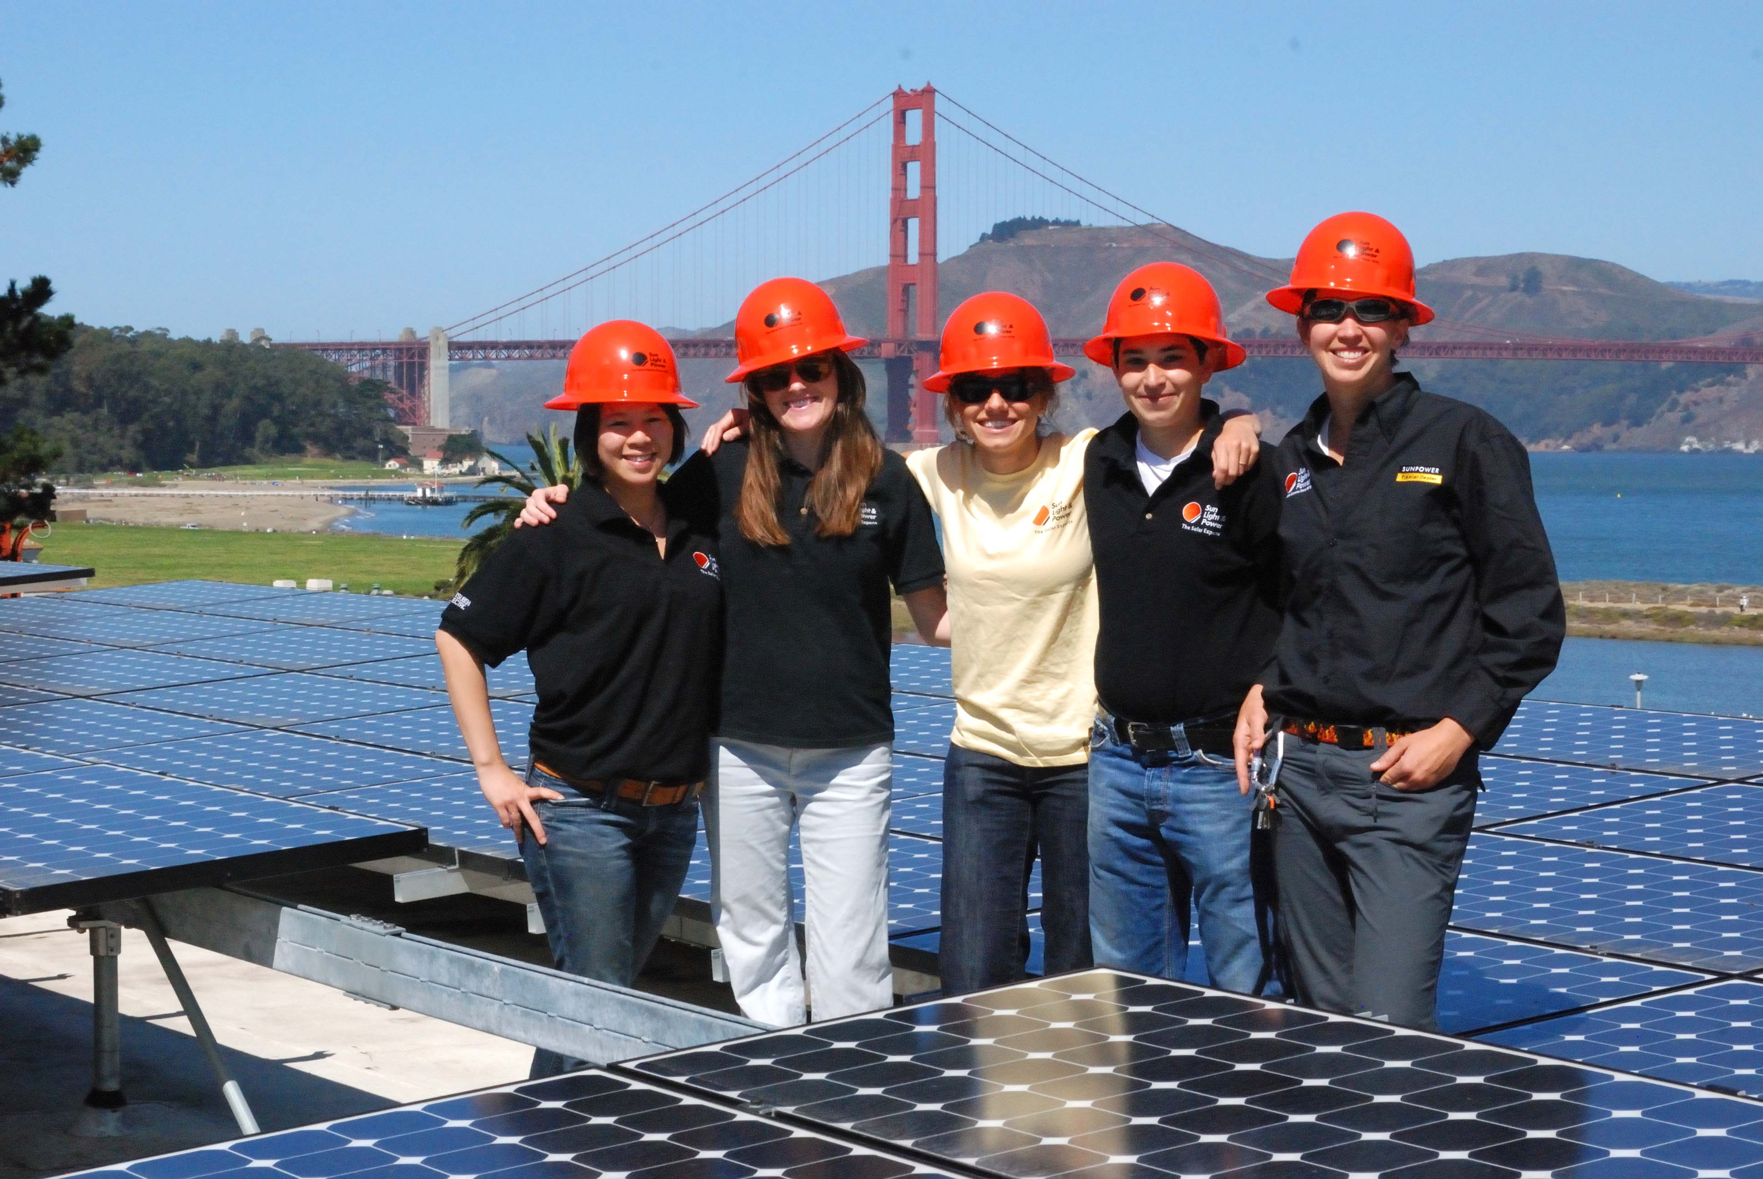
Making NABCEP count
Reward NABCEP certificants financially
Pay for NABCEP training
Provide company facilities for NABCEP training
Provide ongoing training (“PV University”)
Notes:
Some call it the three E’s -- equity, the environment, and the economy. Others label it the three P’s -- people, the planet, and profits. Whichever letter in the alphabet they use, companies of all sizes and shapes around the world are seriously embracing sustainability practices and processes in their core business functions.
Regardless of the descriptive language, companies know that their top and bottom lines will increasingly depend on how deeply they commit to sustainability and how accurately they track, measure, and report their progress in this area. In view of this looming financial imperative, many large global enterprises, including Walmart, have already plowed significant time, energy, and resources into sustainability efforts. But so have small- and medium-size firms on Main Street. A recent study of 20,000 of these companies in Ohio, Pennsylvania, and North Carolina, for instance, found that 70 percent are adopting sustainable business practices because they increase success. Bob Bunting: October 4, 2010
A New Wave of Measurement and Reporting Is on the Way http://www.greentechmedia.com/articles/read/a-new-wave-of-measurement-and-reporting-is-on-the-way/
There are five main reasons companies are interested in conducting business in a sustainable manner:
Supplier networks demand it. Companies such as Walmart, which has more than 100,000 suppliers, are now requiring that vendors collaborate on sustainability initiatives. If a business wants to continue receiving orders from big customers like this, it will follow suit on sustainability.
Government contracts necessitate it. City, state, and federal purchasing agents are, in more and more cases, not permitted to do business with vendors who have a poor or nonexistent track record when it comes to sustainability. Over time, sustainability, diversity, and price may become the three most important variables for winning public-sector contracts.
Customers require it. More than 80 percent of all consumers surveyed in a 2009 national poll indicated that it’s somewhat or very important that the companies they purchase from practice sustainable business.
Potential employees insist on it. A recent study of employees between the ages of 18 and 35 in the United States, the European Union, India, and China found that 96 percent of them want to work for a company that’s committed to sustainability.
Public policy encourages it. President Obama has said that he wants 25 percent of our nation’s energy to be renewable by 2025. And the states have been busy shaping energy policy, too. Right now, 46 states are using tax incentives to help boost renewable energy companies, 32 states offer financing or loans for companies seeking to expand their renewable energy presence, 22 states provide rebates for renewable energy activities, 29 states and the District of Columbia have established renewable portfolio standards, and 19 states have embraced energy efficiency standards.

Slide 7
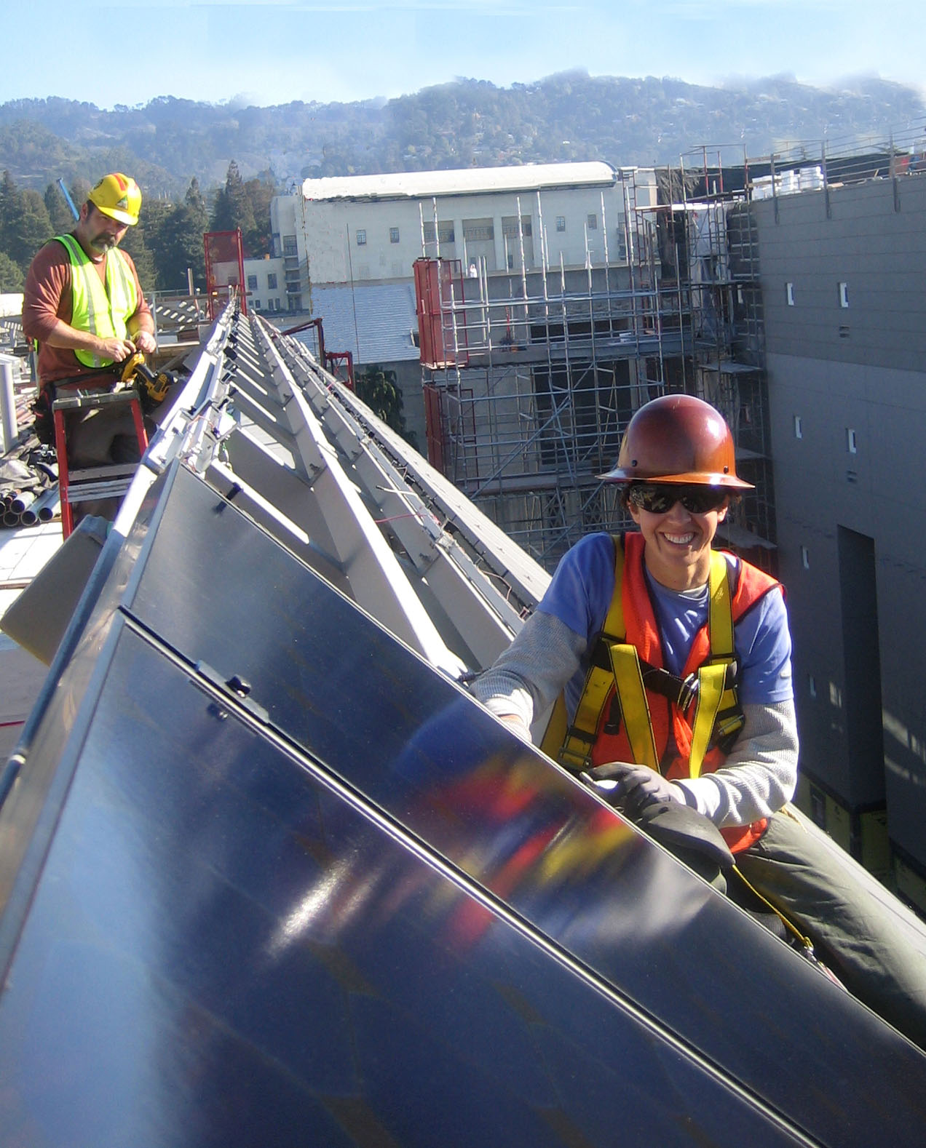
Safety is paramount
Besides the moral imperative of keeping those in your employ safe, there are practical business reasons to emphasize safety:
Lower insurance costs (lower Xmod)
Less valuable time lost to injuries
Better morale, more loyalty
A single bad accident can sink your business

Slide 8
Keep it tight
Subcontracting = potential loss of control/quality
Train and manage your own crews - they are your true asset
AND
Train your Project Managers to properly manage subcontractors
Look for subs with NABCEP certificants
Treat your subcontractors well – their success is your success
Notes:
Some call it the three E’s -- equity, the environment, and the economy. Others label it the three P’s -- people, the planet, and profits. Whichever letter in the alphabet they use, companies of all sizes and shapes around the world are seriously embracing sustainability practices and processes in their core business functions.
Regardless of the descriptive language, companies know that their top and bottom lines will increasingly depend on how deeply they commit to sustainability and how accurately they track, measure, and report their progress in this area. In view of this looming financial imperative, many large global enterprises, including Walmart, have already plowed significant time, energy, and resources into sustainability efforts. But so have small- and medium-size firms on Main Street. A recent study of 20,000 of these companies in Ohio, Pennsylvania, and North Carolina, for instance, found that 70 percent are adopting sustainable business practices because they increase success. Bob Bunting: October 4, 2010
A New Wave of Measurement and Reporting Is on the Way http://www.greentechmedia.com/articles/read/a-new-wave-of-measurement-and-reporting-is-on-the-way/
There are five main reasons companies are interested in conducting business in a sustainable manner:
Supplier networks demand it. Companies such as Walmart, which has more than 100,000 suppliers, are now requiring that vendors collaborate on sustainability initiatives. If a business wants to continue receiving orders from big customers like this, it will follow suit on sustainability.
Government contracts necessitate it. City, state, and federal purchasing agents are, in more and more cases, not permitted to do business with vendors who have a poor or nonexistent track record when it comes to sustainability. Over time, sustainability, diversity, and price may become the three most important variables for winning public-sector contracts.
Customers require it. More than 80 percent of all consumers surveyed in a 2009 national poll indicated that it’s somewhat or very important that the companies they purchase from practice sustainable business.
Potential employees insist on it. A recent study of employees between the ages of 18 and 35 in the United States, the European Union, India, and China found that 96 percent of them want to work for a company that’s committed to sustainability.
Public policy encourages it. President Obama has said that he wants 25 percent of our nation’s energy to be renewable by 2025. And the states have been busy shaping energy policy, too. Right now, 46 states are using tax incentives to help boost renewable energy companies, 32 states offer financing or loans for companies seeking to expand their renewable energy presence, 22 states provide rebates for renewable energy activities, 29 states and the District of Columbia have established renewable portfolio standards, and 19 states have embraced energy efficiency standards.

Slide 9
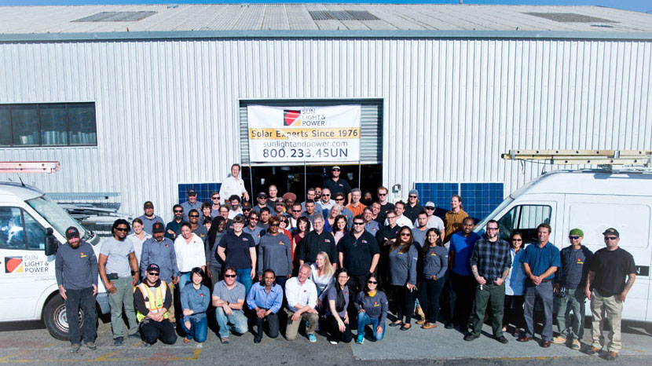
Size matters
Our recent Tipping Point:
Moving from 50 to 85 people
New Quality Assurance Specialist
New Technical Innovation and Excellence senior position
Chief Superintendent has more time allocated to safety now
Notes:
Some call it the three E’s -- equity, the environment, and the economy. Others label it the three P’s -- people, the planet, and profits. Whichever letter in the alphabet they use, companies of all sizes and shapes around the world are seriously embracing sustainability practices and processes in their core business functions.
Regardless of the descriptive language, companies know that their top and bottom lines will increasingly depend on how deeply they commit to sustainability and how accurately they track, measure, and report their progress in this area. In view of this looming financial imperative, many large global enterprises, including Walmart, have already plowed significant time, energy, and resources into sustainability efforts. But so have small- and medium-size firms on Main Street. A recent study of 20,000 of these companies in Ohio, Pennsylvania, and North Carolina, for instance, found that 70 percent are adopting sustainable business practices because they increase success. Bob Bunting: October 4, 2010
A New Wave of Measurement and Reporting Is on the Way http://www.greentechmedia.com/articles/read/a-new-wave-of-measurement-and-reporting-is-on-the-way/
There are five main reasons companies are interested in conducting business in a sustainable manner:
Supplier networks demand it. Companies such as Walmart, which has more than 100,000 suppliers, are now requiring that vendors collaborate on sustainability initiatives. If a business wants to continue receiving orders from big customers like this, it will follow suit on sustainability.
Government contracts necessitate it. City, state, and federal purchasing agents are, in more and more cases, not permitted to do business with vendors who have a poor or nonexistent track record when it comes to sustainability. Over time, sustainability, diversity, and price may become the three most important variables for winning public-sector contracts.
Customers require it. More than 80 percent of all consumers surveyed in a 2009 national poll indicated that it’s somewhat or very important that the companies they purchase from practice sustainable business.
Potential employees insist on it. A recent study of employees between the ages of 18 and 35 in the United States, the European Union, India, and China found that 96 percent of them want to work for a company that’s committed to sustainability.
Public policy encourages it. President Obama has said that he wants 25 percent of our nation’s energy to be renewable by 2025. And the states have been busy shaping energy policy, too. Right now, 46 states are using tax incentives to help boost renewable energy companies, 32 states offer financing or loans for companies seeking to expand their renewable energy presence, 22 states provide rebates for renewable energy activities, 29 states and the District of Columbia have established renewable portfolio standards, and 19 states have embraced energy efficiency standards.

Slide 10
Keep improving
Struggles:
Keeping the key people on site to truly finish the job (commissioning, paperwork)
Make sure that people pay attention to fatigue and take extra breaks if they need them
Innovate:
Surprise your team with an inspection
Notes:
Some call it the three E’s -- equity, the environment, and the economy. Others label it the three P’s -- people, the planet, and profits. Whichever letter in the alphabet they use, companies of all sizes and shapes around the world are seriously embracing sustainability practices and processes in their core business functions.
Regardless of the descriptive language, companies know that their top and bottom lines will increasingly depend on how deeply they commit to sustainability and how accurately they track, measure, and report their progress in this area. In view of this looming financial imperative, many large global enterprises, including Walmart, have already plowed significant time, energy, and resources into sustainability efforts. But so have small- and medium-size firms on Main Street. A recent study of 20,000 of these companies in Ohio, Pennsylvania, and North Carolina, for instance, found that 70 percent are adopting sustainable business practices because they increase success. Bob Bunting: October 4, 2010
A New Wave of Measurement and Reporting Is on the Way http://www.greentechmedia.com/articles/read/a-new-wave-of-measurement-and-reporting-is-on-the-way/
There are five main reasons companies are interested in conducting business in a sustainable manner:
Supplier networks demand it. Companies such as Walmart, which has more than 100,000 suppliers, are now requiring that vendors collaborate on sustainability initiatives. If a business wants to continue receiving orders from big customers like this, it will follow suit on sustainability.
Government contracts necessitate it. City, state, and federal purchasing agents are, in more and more cases, not permitted to do business with vendors who have a poor or nonexistent track record when it comes to sustainability. Over time, sustainability, diversity, and price may become the three most important variables for winning public-sector contracts.
Customers require it. More than 80 percent of all consumers surveyed in a 2009 national poll indicated that it’s somewhat or very important that the companies they purchase from practice sustainable business.
Potential employees insist on it. A recent study of employees between the ages of 18 and 35 in the United States, the European Union, India, and China found that 96 percent of them want to work for a company that’s committed to sustainability.
Public policy encourages it. President Obama has said that he wants 25 percent of our nation’s energy to be renewable by 2025. And the states have been busy shaping energy policy, too. Right now, 46 states are using tax incentives to help boost renewable energy companies, 32 states offer financing or loans for companies seeking to expand their renewable energy presence, 22 states provide rebates for renewable energy activities, 29 states and the District of Columbia have established renewable portfolio standards, and 19 states have embraced energy efficiency standards.

Slide 11
CONTACT INFORMATION
Gary Gerber, CEO
Gary@sunlightandpower.com
(510) 845-2997 (800) 233-4SUN
www.sunlightandpower.com

