Slide 1
NABCEP Conference March 22nd, 2017
Chad Waits
Net Zero Solar

Slide 2
Company and NABCEP History
Started in solar in 2002
NABCEP Certified in PV since 2007, SHW in 2010
Opened Net Zero Solar in 2008
Grid tied, Off grid, Water Pumping, Small commercial.
10 Teammates

Slide 3
Why NABCEP?
Where is the value in NABCEP for me personally?
Respect
Where is the value in NABCEP for my company?
Sets standards and expectations for teammates.
Outline for constant improvement.
Notes:
Talk about personal goals in and how respect always drives decision making.
Talk about growth and the “being happy” trade off for me..
Sustainability in business and life. Shorter work weeks.
Being critical of our processes and refining them.
Our guys know our commitment to quality. They see it everyday and in our continuing commitment to NABCEP education and standards. We use NACEP as our “moral business compass”

Slide 4
Topics
Small business model of Owner sales and how we are making the transition to a salesman/employee sales.
AZ regulatory challenges and how NABCEP has helped shape our strategy
Internal and External Relationships

Slide 5
Owner to Salesman-Employee Transition
Tough letting things go
Training, training, training….
Articulating value
Compensation models to drive quality sales?
Notes:
-Show of hands about business sizes? 10-12 and under.
-How long did you train your salespeople? Do they gather all of the site data?
-Training obviously ongoing but didn’t cut Brian loose for almost 8 months and how I’m still mentoring daily. Talk about 1st scope with Brian.
-System scope/intake SOP had to be stressed.
- Stressing that cheaper isn’t always the best value. Strength of company is measured in more ways than gross sales. Commitment to craft, community, and strong customer relationships.
-Compensation? Talk about Brian and an hourly employee. Didn’t want sales to be the sole driver. Quality customers are our target and growth (or more precisely the rapid growth model) only model I think has not proven to be all that successful. I want my salesman to be confident and not feel like he’s taking food off the table and save us the headaches down the road.

Slide 6
Conveying Value Proposition and Site Analysis
Meeting peoples goals
Quality products, services, and relationships
Simple design techniques
Moving away from the ROI sales model
Notes:
Understanding how different people have different means of assessing value. What type of system is going to meet the clients expectations. He’s got to get into what the clients really want.
LG offering, our process from start to finish and the communication that keeps them involved in the project, How’s this going to look in 20 years? Then the wrap up/ongoing support.
Knowing our strengths and playing to them. Talk about Enphase and how that model makes it easier for the salesman to sell.
Don’t expect a green salesperson to jump into off grid design right off the bat.
Touch on how all of the financial modeling tools/techniques we’re having to through them out the window and start over.
What drivers can we use that are not all about ROI. If you sell a more expensive product that has ROI numbers that are greater than the contract

Slide 7
AZ Regulatory Challenges
Net Metering decision – Value of Solar
No more banking kWh’s
New Export Rates for all utilities.
Resource Comparison Proxy
Avoided Cost Methodology
Legislative restrictions on financial modeling.
Notes:
Talk briefly about the net metering changes and methodologies.
AZ legislative restrictions and how that has changed the landscape for solar adoption. Consumer protection driven but also poorly conceived and backed by competing (utility) business models.
Talk briefly on finer points/restrictions. Longer interconnection approval times. Financial modeling that has to show rates without solar, with solar and +-5%.

Slide 8
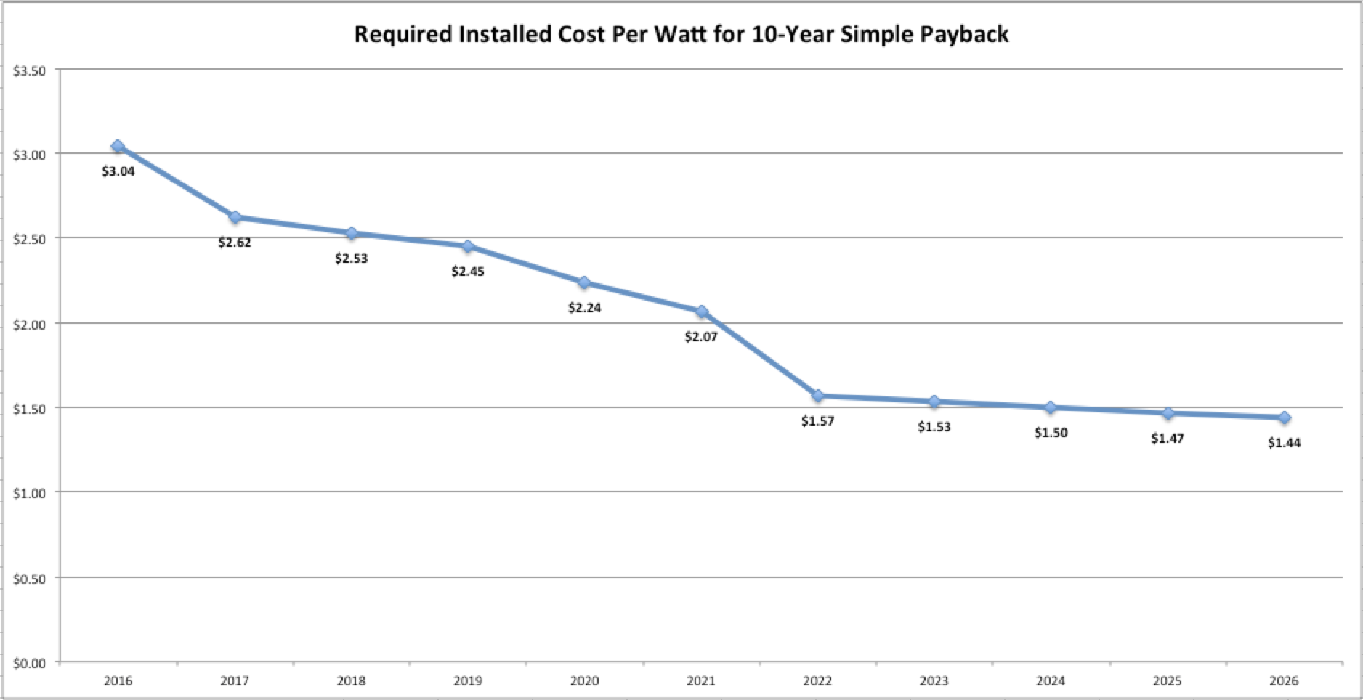
Notes:
Note assumption of 50% consumption and how low pricing has to get to get to simple 10 year ROI

Slide 9
What strategies have been born out of NABCEP?
Identifying Customer Needs
Design
Energy Management
Energy Storage
Lower Cost Equipment
Managing Customer Expectations
Financial Modeling changes
Longer wait - Installation timelines
Notes:
Needs
Smaller systems will become the norm.
Enphase’s Energy management system where everything is simple and on one platform that can grow with new rates and customer desires.
If its truly a ROI driver for the customer then we’ll need offer a lower cost product without hurting our efficiency and other value propositions. Lower cost module to keep the ROI at a level that will still encourage healthy adoption rates.
Expectations
Financial modeling becomes much more complex in that without proper interval data it’s very difficult to be accurate.
Being clear about and documenting assumptions. If you don’t have the data, clear assumptions will help with customer confusion. Note Energy Sages number 1 reason for not purchasing – Customer Confusion
Timelines for both proposals and installations may increase due to legislative restrictions. If you have to input loads of data into a tool, depending on format, could take a while. Also your first design might not be the best (orientation vs. load) and you may have to run several scenarios.
Utilities have slowed installation timelines by giving themselves 60 days to approve an application for interconnection.

Slide 10
Internal and External Relationships
Stay connected to your teammates.
May also help to engage competitors/colleagues.
Policy partners
Can also assist in sharing best practices
Notes:
We spend time with our people in the field, on sales calls, and recreationally. This helps them understand our commitment to quality in both professional and personal situations.
Talk about SASSB and how that experience forged a better product and continues to this day in policy battles. Trade organizations are great but they only make the introductions. SASSB allowed us to really expand those relationships and really share valuable information amongst each other.

Slide 11
Wrap up
NABCEP is our moral business compass
Business strategies propagate from NABCEP guidelines.
New challenges will continually require shifts in strategy.
Spend time with your people and your colleagues.
Notes:
Maybe talk about SASSB and how much reaching out to colleagues helped Net Zero grow with the sharing of best practices. Also, how those relationships continue to help in collaborative actions on both technical and policy fronts.

